Slide 1


Measuring Classifier Performance
08
PART II · LINEAR MODELS AND GENERALIZATION
CHAPTER 8 · WEEK 7
Machine Learning — From Hypotheses to Decisions
LECTURER
Dr. Mustafa Hameed
THE ISLAMIA UNIVERSITY OF BAHAWALPUR
Bahawalpur, Pakistan
Department of Information Technology · BSIT · Fall 2026
Notes:
Chapter 8: Measuring Classifier Performance. Part 2 — Linear Models and Generalization. Week 7: Measuring classifier performance. Handout pages 60–69.

Slide 2

Where this chapter sits
THE COURSE
PART I
PART II
PART III
PART IV
PART V
PART VI
1
2
3
4
5
6
7
8
9
10
11
12
13
14
15
16
17
18
19
20
21
22
Measuring Classifier Performance
BUILDS ON
USED LATER IN
Ch 2 Mathematics for Machine Learning
Ch 18 Hidden Markov Models
Ch 6 Logistic Regression
Ch 21 Responsible and Ethical Machine Learning
Ch 7 Overfitting, Bias–Variance and Regularisation
Ch 22 The Machine Learning Project
Machine Learning · Chapter 8 · Measuring Classifier Performance
Handout p. 60 2
Notes:
Place the chapter. Before you start: Chapter 2 (the base-rate calculation), Chapter 6 (probabilities and thresholds) and Chapter 7 (cross-validation; the test set used once).

Slide 3

What you will be able to do
LEARNING OUTCOMES
By the end of this chapter you will be able to:
1
Build a confusion matrix and compute accuracy, precision, recall, specificity and F₁ from it.
2
Explain why accuracy misleads on imbalanced classes, and choose a metric that matches the cost of each error.
3
Read ROC and precision–recall curves, and choose a decision threshold from costs.
4
Compute macro- and micro-averaged metrics for several classes.
5
Construct a confidence interval for an error rate, and test whether two classifiers genuinely differ.
Machine Learning · Chapter 8 · Measuring Classifier Performance
Handout p. 60 3
Notes:
Read these out: they are the chapter's contract with the room. Each click adds one.

Slide 4

Vocabulary for this chapter
KEY TERMS
confusion matrix
true/false positive/negative
accuracy
precision
recall (sensitivity)
specificity
F1 score
class imbalance
ROC curve
AUC
precision–recall curve
operating threshold
macro and micro averaging
sample error
true error
confidence interval
McNemar’s test
Each term is defined where it first matters — not here.
Machine Learning · Chapter 8 · Measuring Classifier Performance
Handout p. 60 4
Notes:
Do not define these now; they arrive one at a time. This slide is for the students' notes. Terms: confusion matrix; true/false positive/negative; accuracy; precision; recall (sensitivity); specificity; F1 score; class imbalance; ROC curve; AUC; precision–recall curve; operating threshold; macro and micro averaging; sample error; true error; confidence interval; McNemar’s test.

Slide 5
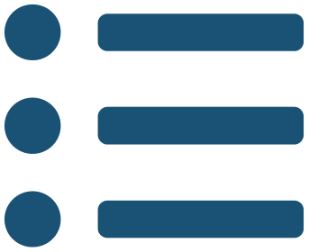
In this chapter
IN THIS CHAPTER
8.1
Measuring Classifier Accuracy Is Not One Number
p. 60 ›
8.2
The Confusion Matrix
p. 60 ›
8.3
Precision, Recall and the Threshold
p. 61 ›
8.4
Threshold-Free Summaries: ROC and PR Curves
p. 62 ›
8.5
More Than Two Classes
p. 63 ›
8.6
How Sure Is the Number? Confidence Intervals for Error
p. 63 ›
8.7
Is One Classifier Really Better? McNemar’s Test
p. 64 ›
8.8
Handling Class Imbalance
p. 64 ›
Machine Learning · Chapter 8 · Measuring Classifier Performance
Handout pp. 60–69 5
Notes:
The route through the chapter. Each row is a link: click it to jump to that section in the slide show.

Slide 6

Measuring Classifier Accuracy Is Not One Number
KEY IDEA
The HEC outline calls this topic measuring classifier accuracy, and the first lesson is that accuracy is usually the wrong measure. A classifier makes two kinds of mistake, and in almost every real problem one costs far more than the other: a missed intrusion against a wasted analyst hour, an undetected failing student against an unnecessary phone call. A single number that adds the two together hides exactly the information needed to decide whether the classifier is any use.
Machine Learning · Chapter 8 · Measuring Classifier Performance
§8.1 · Handout p. 60 6
Notes:
Say this in your own words first; the slide is the handout's wording.

Slide 7
The Confusion Matrix
SECTION 2 OF 8
8.2
8.1 Measuring Classifier Accuracy Is Not One Number
8.2 The Confusion Matrix
8.3 Precision, Recall and the Threshold
8.4 Threshold-Free Summaries: ROC and PR Curves
8.5 More Than Two Classes
8.6 How Sure Is the Number? Confidence Intervals for Error
8.7 Is One Classifier Really Better? McNemar’s Test
8.8 Handling Class Imbalance
Machine Learning · Chapter 8
Handout §8.2 7
Notes:
Pause. Name the question this section answers.

Slide 8

Confusion Matrix
DEFINITION
For two classes, cross-tabulate the predictions against the truth:
• true positive (TP): positive, predicted positive;
• false positive (FP): negative, predicted positive — a false alarm;
• false negative (FN): positive, predicted negative — a miss;
• true negative (TN): negative, predicted negative.
Every metric in this chapter is a ratio of these four counts.
Machine Learning · Chapter 8 · Measuring Classifier Performance
§8.2 · Handout p. 60 8
Notes:
Read the box aloud, then ask for an example from the room before moving on.

Slide 9
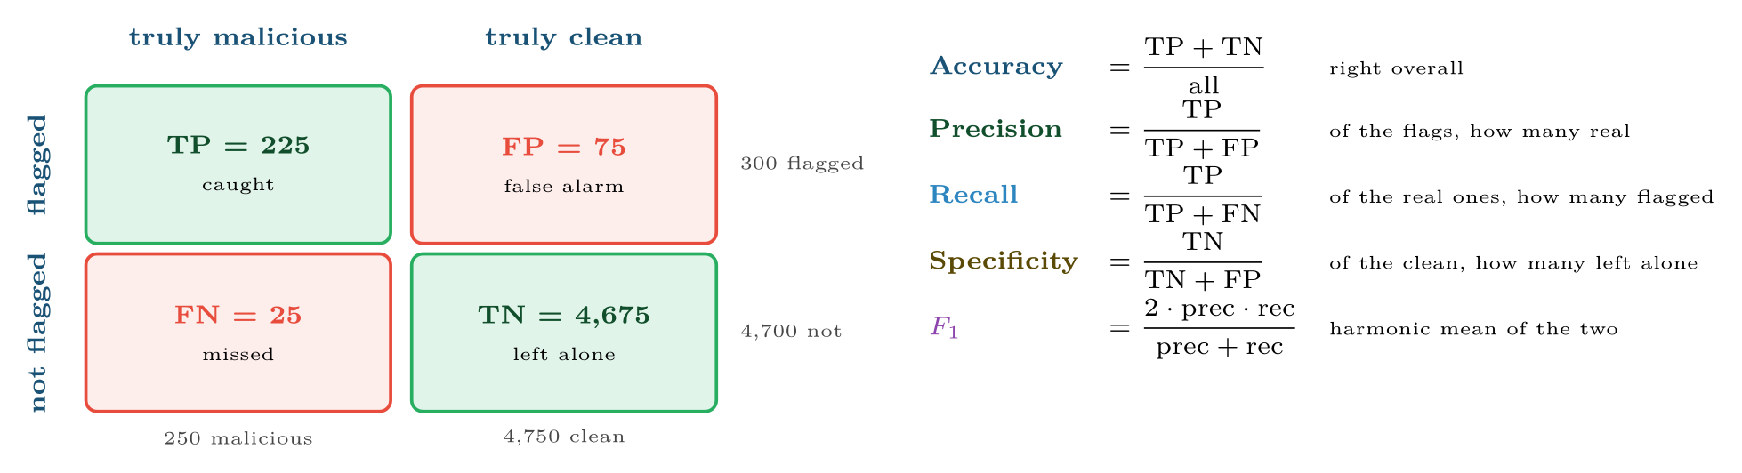
A malware scanner’s confusion matrix on 5,000 files, and the five metrics computed from it
FIGURE 8.1
Precision reads along the “flagged” row; recall reads down the “truly malicious” column.
Machine Learning · Chapter 8 · Measuring Classifier Performance
§8.2 · Handout p. 60 9
Notes:
Figure 8.1 (handout p. 61): A malware scanner’s confusion matrix on 5,000 files, and the five metrics computed from it. Precision reads along the “flagged” row; recall reads down the “truly malicious” column.

Slide 10

One Scanner, Five Metrics
WORKED EXAMPLE
The scanner of Figure 8.1 examined 5,000 files, of which 250 were malicious. It flagged 300, of which 225 were malicious.
Cells: TP = 225, FP = 300 − 225 = 75, FN = 250 − 225 = 25, TN = 5000 − 225 − 75 − 25 = 4675.
• Accuracy = (225 + 4675)/5000 = 98.0%
• Precision = 225/300 = 75.0%
• Recall = 225/250 = 90.0%
• Specificity = 4675/4750 = 98.4%
•
Against the baseline. “Flag nothing” is right on the 4,750 clean files: 95.0% accuracy. The scanner’s 98.0% is three points better than doing nothing, which sounds small; its recall of 90% — nine malicious files in ten caught, at the cost of one false alarm for every three real detections — is what actually describes it.
Machine Learning · Chapter 8 · Measuring Classifier Performance
§8.2 · Handout p. 60 10
Notes:
Each click adds one step of the working. Ask for the next number before you reveal it.

Slide 11

The Accuracy Paradox
WATCH OUT
When one class is rare, accuracy is dominated by the common class. A detector for an event that occurs in 1% of cases can be 99% accurate by never detecting anything. Compute the majority-class baseline before looking at any accuracy figure, and report precision and recall instead.
Machine Learning · Chapter 8 · Measuring Classifier Performance
§8.2 · Handout p. 60 11
Notes:
Read the box aloud, then ask for an example from the room before moving on.

Slide 12
Choosing an Operating Threshold From Costs
WORKED EXAMPLE
For the malware scanner, a missed malicious file (FN) is estimated to cost 50 times as much as a false alarm (FP) — an infection against ten minutes of an analyst’s time. The scanner’s precision and recall at four thresholds, with 250 malicious files:
Threshold | Precision | Recall | TP | FN | FP | Cost = 50 FN + FP
0.3 | 0.55 | 0.96 | 240 | 10 | 196 | 696
0.5 | 0.75 | 0.90 | 225 | 25 | 75 | 1,325
0.7 | 0.86 | 0.78 | 195 | 55 | 32 | 2,782
0.9 | 0.95 | 0.52 | 130 | 120 | 7 | 6,007
(TP = recall × 250; FP = TP × (1 − precision)/precision.)
The cheapest threshold is 0.3, which almost halves the cost of the default 0.5 by accepting 121 more false alarms to catch 15 more infections. With a cost ratio of 1:1 the answer would be different. The threshold is where the business decision enters the model.
Machine Learning · Chapter 8 · Measuring Classifier Performance
§8.3 · Handout p. 61 12
Notes:
A probabilistic classifier (Chapter 6) does not flag or clear anything by itself; it outputs a score, and a threshold turns scores into decisions. Lower the threshold and more cases are flagged: recall rises and precision falls. Raise it and the reverse happens. Neither can be maximised without sacrificing the other, so the threshold must be chosen from the costs of the two errors — which is a decision about the application, not about the algorithm.
Each click adds one step of the working. Ask for the next number before you reveal it.

Slide 13
Threshold-Free Summaries: ROC and PR Curves
SECTION 4 OF 8
8.4
8.1 Measuring Classifier Accuracy Is Not One Number
8.2 The Confusion Matrix
8.3 Precision, Recall and the Threshold
8.4 Threshold-Free Summaries: ROC and PR Curves
8.5 More Than Two Classes
8.6 How Sure Is the Number? Confidence Intervals for Error
8.7 Is One Classifier Really Better? McNemar’s Test
8.8 Handling Class Imbalance
Machine Learning · Chapter 8
Handout §8.4 13
Notes:
Pause. Name the question this section answers.

Slide 14
ROC Curve and AUC
DEFINITION
The ROC curve plots the true positive rate (recall) against the false positive rate (1 − specificity) at every possible threshold. The area under the curve (AUC) summarises it: the probability that the classifier scores a randomly chosen positive above a randomly chosen negative. A random classifier has AUC 0.5; a perfect one, 1.0.
Machine Learning · Chapter 8 · Measuring Classifier Performance
§8.4 · Handout p. 62 14
Notes:
Read the box aloud, then ask for an example from the room before moving on.

Slide 15
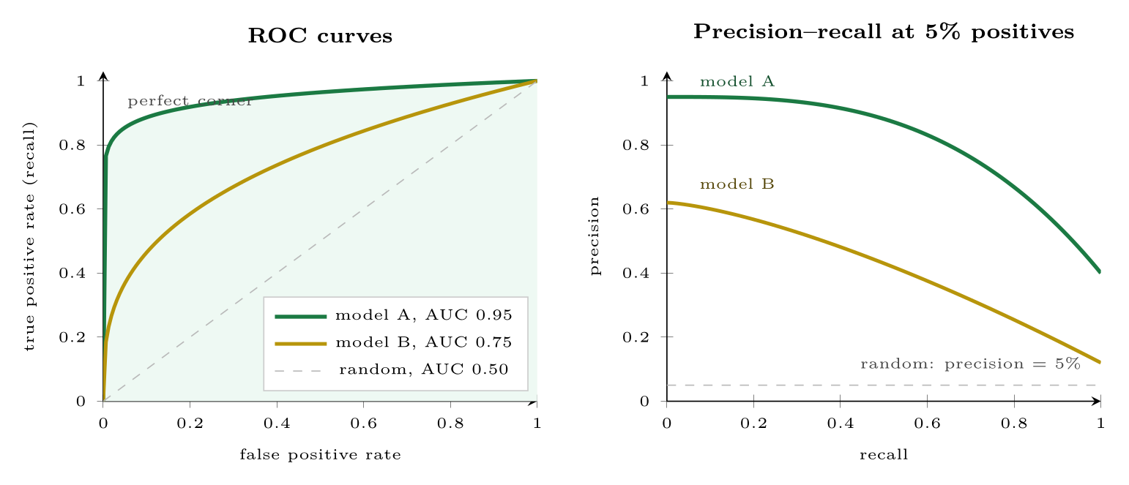
Threshold-Free Summaries: ROC and PR Curves
FIGURE 8.2
Left: ROC curves sweep every threshold; the shaded area is model A’s AUC. Right: the same two models on precision and recall. With rare positives the PR plot shows how many alerts are false, which the ROC plot hides.
Machine Learning · Chapter 8 · Measuring Classifier Performance
§8.4 · Handout p. 62 15
Notes:
Figure 8.2 (handout p. 62): Left: ROC curves sweep every threshold; the shaded area is model A’s AUC. Right: the same two models on precision and recall. With rare positives the PR plot shows how many alerts are false, which the ROC plot hides.

Slide 16
Prefer Precision–Recall When Positives Are Rare
WATCH OUT
The ROC false positive rate divides false alarms by the (huge) number of negatives, so hundreds of false alarms can look like a rate of 0.01. A precision–recall curve uses precision directly and does not flatter a rare-event detector. For intrusion, fraud and failure detection, report the PR curve or its area (average precision), and quote precision at the recall the application needs.
Machine Learning · Chapter 8 · Measuring Classifier Performance
§8.4 · Handout p. 62 16
Notes:
Read the box aloud, then ask for an example from the room before moving on.

Slide 17
Macro Against Micro
WORKED EXAMPLE
A traffic classifier is tested on 100 flows: 80 web, 15 e-mail, 5 streaming. It labels 76 web, 9 e-mail and 1 streaming flow correctly.
Per-class recall: web 76/80 = 0.95; e-mail 9/15 = 0.60; streaming 1/5 = 0.20.
Micro (accuracy): (76 + 9 + 1)/100 = 0.86.
Macro: (0.95 + 0.60 + 0.20)/3 = 0.58.
The micro figure is carried by the web class; the macro figure reveals that the classifier almost never recognises streaming. If the rare classes matter — and in security they usually are the ones that matter — report the macro figure and the per-class table.
Machine Learning · Chapter 8 · Measuring Classifier Performance
§8.5 · Handout p. 63 17
Notes:
With k classes the confusion matrix is k × k, and precision and recall are computed for each class in turn, treating it as positive and the rest as negative. They are then combined in one of two ways. Macro averaging takes the plain mean of the per-class values, so every class counts equally. Micro averaging pools the counts first, so every example counts equally — and micro-averaged recall equals accuracy.
Each click adds one step of the working. Ask for the next number before you reveal it.

Slide 18
How Sure Is the Number? Confidence Intervals for Error
SECTION 6 OF 8
8.6
8.1 Measuring Classifier Accuracy Is Not One Number
8.2 The Confusion Matrix
8.3 Precision, Recall and the Threshold
8.4 Threshold-Free Summaries: ROC and PR Curves
8.5 More Than Two Classes
8.6 How Sure Is the Number? Confidence Intervals for Error
8.7 Is One Classifier Really Better? McNemar’s Test
8.8 Handling Class Imbalance
Machine Learning · Chapter 8
Handout §8.6 18
Notes:
Pause. Name the question this section answers.

Slide 19

How Sure Is the Number? Confidence Intervals for Error
IN BRIEF
A test set is a sample, so the error measured on it is an estimate. Mitchell distinguishes the sample error error_{S}(h), the fraction of the n test examples misclassified, from the true error error_{D}(h) over the whole population. Because each test example is an independent yes/no trial, the number of mistakes is binomial, and for n ≥ 30 an approximate 95% confidence interval for the true error is
Machine Learning · Chapter 8 · Measuring Classifier Performance
§8.6 · Handout p. 63 19
Notes:
A test set is a sample, so the error measured on it is an estimate. Mitchell distinguishes the sample error errorS(h), the fraction of the n test examples misclassified, from the true error errorD(h) over the whole population. Because each test example is an independent yes/no trial, the number of mistakes is binomial, and for n ≥ 30 an approximate 95% confidence interval for the true error is

Slide 20
How Wide Is 12% Error?
WORKED EXAMPLE
A classifier misclassifies 24 of n = 200 test examples: error_{S} = 0.12.
95% interval: 0.12 ± 0.045, that is 7.5% to 16.5%.
With n = 2000 and the same 12% error, the half-width shrinks to 1.96√(0.12 × 0.88/2000) = 0.014: 10.6% to 13.4%. Ten times the data gives an interval about √(10) ≈ 3.2 times narrower. On 200 examples, a competitor at 10% error is not demonstrably better.
Machine Learning · Chapter 8 · Measuring Classifier Performance
§8.6 · Handout p. 63 20
Notes:
Each click adds one step of the working. Ask for the next number before you reveal it.

Slide 21
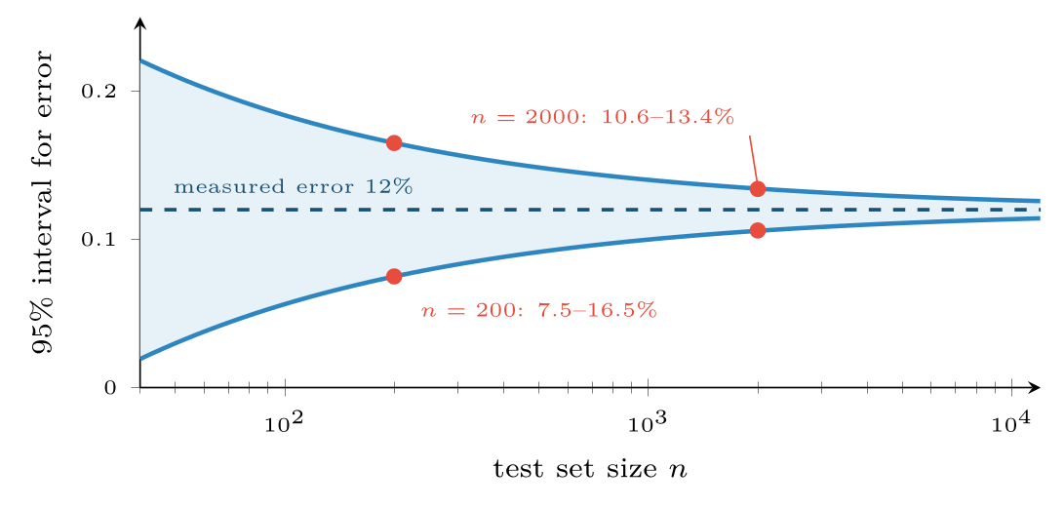
How the uncertainty in a measured 12% error rate shrinks with test-set size
FIGURE 8.3
The width falls as 1/√n: four times the data halves it.
Machine Learning · Chapter 8 · Measuring Classifier Performance
§8.6 · Handout p. 63 21
Notes:
Figure 8.3 (handout p. 63): How the uncertainty in a measured 12% error rate shrinks with test-set size. The width falls as 1/√n: four times the data halves it.

Slide 22
Is One Classifier Really Better? McNemar’s Test
IN BRIEF
Two classifiers are tested on the same examples and one scores a little higher. Is it better, or luckier? Only the examples on which they disagree carry information. Let b be the number that classifier A gets wrong and B gets right, and c the number A gets right and B wrong. If the two are equally good, b and c should be similar. McNemar’s test statistic
Machine Learning · Chapter 8 · Measuring Classifier Performance
§8.7 · Handout p. 64 22
Notes:
Two classifiers are tested on the same examples and one scores a little higher. Is it better, or luckier? Only the examples on which they disagree carry information. Let b be the number that classifier A gets wrong and B gets right, and c the number A gets right and B wrong. If the two are equally good, b and c should be similar. McNemar’s test statistic

Slide 23
McNemar on 500 Test Emails
WORKED EXAMPLE
A spam classifier A and a new classifier B are run on the same 500 e-mails. They disagree on 40: B is right and A wrong on b = 12; A is right and B wrong on c = 28.
A is significantly better at the 5% level (p ≈ 0.018): it is right on 16 more e-mails, 3.2 points of accuracy. The 460 e-mails on which they agree play no part — which is why the test is sensitive even when the accuracies look close. When the comparison is across cross-validation folds instead of one test set, the equivalent tool is a paired t-test on the per-fold scores.
Machine Learning · Chapter 8 · Measuring Classifier Performance
§8.7 · Handout p. 64 23
Notes:
is compared with 3.84, the 95% point of the chi-squared distribution with one degree of freedom; a larger value means the difference is unlikely to be chance.
Each click adds one step of the working. Ask for the next number before you reveal it.

Slide 24
Handling Class Imbalance
IN BRIEF
Imbalance is a problem for training as well as evaluation: a learner minimising average loss can do very well by ignoring the rare class. Three remedies, in order of preference:
1. Move the threshold. Train normally, then choose the threshold from costs, as above. It changes nothing about the model and is easy to revisit.
2. Weight the classes. Make each error on the rare class cost more in the loss (class_weight="balanced" in scikit-learn).
3. Resample the training data. Undersample the common class, or oversample the rare one (by duplication, or by synthesising new examples with SMOTE). Resample only the training folds — never the validation or test data, whose class balance must stay real.
Machine Learning · Chapter 8 · Measuring Classifier Performance
§8.8 · Handout p. 64 24
Notes:
Read the box aloud, then ask for an example from the room before moving on.

Slide 25

Common pitfalls
COMMON PITFALLS
✕
Reporting accuracy on imbalanced data without the majority baseline beside it.
✕
Quoting precision without recall, or either without the threshold at which it was measured.
✕
Using ROC-AUC alone for rare events. Report the PR curve.
✕
Declaring a winner from a one-point difference on a few hundred test examples. Compute the interval or run McNemar’s test.
✕
Resampling before splitting, which puts copies of the same rare example into both training and test sets.
Machine Learning · Chapter 8 · Measuring Classifier Performance
§8.8 · Handout p. 64 25
Notes:
For each pitfall, ask who has seen it happen. One real story beats five bullets.

Slide 26





Four lenses: Choosing the Metric
FOUR LENSES
LEARNING ANALYTICS
PROJECT MANAGEMENT
Recall at a fixed outreach budget: the advisers can call 50 students, so report how many of the eventual failures are among the top 50 scores.
Over- and under-predicting a project overrun cost roughly the same, so F₁ or balanced accuracy is reasonable.
INTERNET OF THINGS
CYBERSECURITY
Failures are rare and a miss can stop a production line, so optimise recall and then cap false alarms at what the maintenance team can inspect.
Report precision at a fixed recall — “62% precision at 90% recall” — and alerts per analyst per hour.
Machine Learning · Chapter 8 · Measuring Classifier Performance
Handout p. 69 26
Notes:
The same method, four domains. Each of the next four slides opens one lens in full.

Slide 27

Learning Analytics: Choosing the Metric
FOUR LENSES
LEARNING ANALYTICS
Project Management
Recall at a fixed outreach budget: the advisers can call 50 students, so report how many of the eventual failures are among the top 50 scores. Precision matters too — if most calls reach students who were fine, the advisers stop trusting the list.
Internet of Things
Cybersecurity
Machine Learning · Chapter 8 · Measuring Classifier Performance
Handout p. 69 27
Notes:
Learning Analytics. Recall at a fixed outreach budget: the advisers can call 50 students, so report how many of the eventual failures are among the top 50 scores. Precision matters too — if most calls reach students who were fine, the advisers stop trusting the list.

Slide 28

Project Management: Choosing the Metric
FOUR LENSES
PROJECT MANAGEMENT
Learning Analytics
Over- and under-predicting a project overrun cost roughly the same, so F₁ or balanced accuracy is reasonable. With 40 projects in the test set, the confidence interval on any rate is about ± 15 points; say so, rather than reporting three significant figures.
Internet of Things
Cybersecurity
Machine Learning · Chapter 8 · Measuring Classifier Performance
Handout p. 69 28
Notes:
Project Management. Over- and under-predicting a project overrun cost roughly the same, so F1 or balanced accuracy is reasonable. With 40 projects in the test set, the confidence interval on any rate is about ± 15 points; say so, rather than reporting three significant figures.

Slide 29

Internet of Things: Choosing the Metric
FOUR LENSES
INTERNET OF THINGS
Learning Analytics
Failures are rare and a miss can stop a production line, so optimise recall and then cap false alarms at what the maintenance team can inspect. Use the PR curve; ROC-AUC will look excellent on a detector the technicians quickly learn to ignore.
Project Management
Cybersecurity
Machine Learning · Chapter 8 · Measuring Classifier Performance
Handout p. 69 29
Notes:
Internet of Things. Failures are rare and a miss can stop a production line, so optimise recall and then cap false alarms at what the maintenance team can inspect. Use the PR curve; ROC-AUC will look excellent on a detector the technicians quickly learn to ignore.

Slide 30

Cybersecurity: Choosing the Metric
FOUR LENSES
CYBERSECURITY
Learning Analytics
Report precision at a fixed recall — “62% precision at 90% recall” — and alerts per analyst per hour. Choose the threshold from the cost ratio, as in the malware example; and compare a new detector with the old on the same traffic with McNemar’s test, not on two different weeks.
Project Management
Internet of Things
Machine Learning · Chapter 8 · Measuring Classifier Performance
Handout p. 69 30
Notes:
Cybersecurity. Report precision at a fixed recall — “62% precision at 90% recall” — and alerts per analyst per hour. Choose the threshold from the cost ratio, as in the malware example; and compare a new detector with the old on the same traffic with McNemar’s test, not on two different weeks.

Slide 31

Try it yourself: Evaluate an Imbalanced Classifier Properly
TRY IT YOURSELF
WHAT YOU WILL DO
1. An imbalanced problem: 5% positives
2. The four cells and the metrics built from them
3. The threshold is a choice: sweep it
4. A 95% confidence interval for the error rate
5. Is a decision tree really different? McNemar's test
THIS WEEK'S LAB
WHAT YOU WILL RUN
RUNNABLE COPY
Week 7: Evaluate an imbalanced classifier
1 listing, 48 lines of Python
code/ch08_evaluate_imbalanced.py
Machine Learning · Chapter 8 · Measuring Classifier Performance
§8.8 · Handout p. 64 31
Notes:
Say what the room will have at the end of the lab, then let them start. Circulate rather than lecture.

Slide 32
Evaluate an Imbalanced Classifier Properly
LAB · STEP 1 OF 6
Set-up
Python · code/ch08_evaluate_imbalanced.py
2
3
4
5
6
7
8
9
import numpy as np
from scipy.stats import chi2
from sklearn.datasets import make_classification
from sklearn.model_selection import train_test_split
from sklearn.linear_model import LogisticRegression
from sklearn.tree import DecisionTreeClassifier
from sklearn.metrics import (confusion_matrix, precision_score, recall_score,
f1_score, roc_auc_score, average_precision_score)
Machine Learning · Chapter 8 · Measuring Classifier Performance
§8.8 · Handout p. 64 32
Notes:
Step 1: Set-up. Read the code aloud; ask what each line would print before running it.

Slide 33
Evaluate an Imbalanced Classifier Properly
LAB · STEP 2 OF 6
An imbalanced problem: 5% positives
Python · code/ch08_evaluate_imbalanced.py
11
12
13
14
15
16
17
18
# --- an imbalanced problem: 5% positives ---------------------------------
X, y = make_classification(n_samples=6000, n_features=12, n_informative=5,
weights=[0.95], flip_y=0.01, random_state=1)
X_tr, X_te, y_tr, y_te = train_test_split(X, y, test_size=0.4,
stratify=y, random_state=1)
print("baseline accuracy (always 0):", round(1 - y_te.mean(), 3))
lr = LogisticRegression(max_iter=1000).fit(X_tr, y_tr)
p = lr.predict_proba(X_te)[:, 1]
Machine Learning · Chapter 8 · Measuring Classifier Performance
§8.8 · Handout p. 64 33
Notes:
Step 2: An imbalanced problem: 5% positives. Read the code aloud; ask what each line would print before running it.

Slide 34
Evaluate an Imbalanced Classifier Properly
LAB · STEP 3 OF 6
The four cells and the metrics built from them
Python · code/ch08_evaluate_imbalanced.py
20
21
22
23
24
25
26
27
28
# --- 1. the four cells and the metrics built from them -------------------
pred = (p > 0.5).astype(int)
tn, fp, fn, tp = confusion_matrix(y_te, pred).ravel()
print(f"TP={tp} FP={fp} FN={fn} TN={tn}")
print(f"accuracy {np.mean(pred == y_te):.3f} "
f"precision {precision_score(y_te, pred):.3f} "
f"recall {recall_score(y_te, pred):.3f} F1 {f1_score(y_te, pred):.3f}")
print(f"ROC-AUC {roc_auc_score(y_te, p):.3f} "
f"PR-AUC {average_precision_score(y_te, p):.3f}")
Machine Learning · Chapter 8 · Measuring Classifier Performance
§8.8 · Handout p. 64 34
Notes:
Step 3: The four cells and the metrics built from them. Read the code aloud; ask what each line would print before running it.

Slide 35
Evaluate an Imbalanced Classifier Properly
LAB · STEP 4 OF 6
The threshold is a choice: sweep it
Python · code/ch08_evaluate_imbalanced.py
30
31
32
33
34
# --- 2. the threshold is a choice: sweep it ------------------------------
for t in (0.1, 0.3, 0.5, 0.7):
pr = (p > t).astype(int)
print(f"threshold {t}: precision {precision_score(y_te, pr):.2f} "
f"recall {recall_score(y_te, pr):.2f}")
Machine Learning · Chapter 8 · Measuring Classifier Performance
§8.8 · Handout p. 64 35
Notes:
Step 4: The threshold is a choice: sweep it. Read the code aloud; ask what each line would print before running it.

Slide 36
Evaluate an Imbalanced Classifier Properly
LAB · STEP 5 OF 6
A 95% confidence interval for the error rate
Python · code/ch08_evaluate_imbalanced.py
36
37
38
39
# --- 3. a 95% confidence interval for the error rate ---------------------
n, e = len(y_te), np.mean(pred != y_te)
half = 1.96 * np.sqrt(e * (1 - e) / n)
print(f"error {e:.3f}, 95% interval [{e - half:.3f}, {e + half:.3f}]")
Machine Learning · Chapter 8 · Measuring Classifier Performance
§8.8 · Handout p. 64 36
Notes:
Step 5: A 95% confidence interval for the error rate. Read the code aloud; ask what each line would print before running it.

Slide 37
Evaluate an Imbalanced Classifier Properly
LAB · STEP 6 OF 6
Is a decision tree really different? McNemar's test
Python · code/ch08_evaluate_imbalanced.py
41
42
43
44
45
46
47
48
49
# --- 4. is a decision tree really different? McNemar's test --------------
tree = DecisionTreeClassifier(max_depth=5, random_state=0).fit(X_tr, y_tr)
a_right = pred == y_te
b_right = tree.predict(X_te) == y_te
b = np.sum(~a_right & b_right) # logistic wrong, tree right
c = np.sum(a_right & ~b_right) # logistic right, tree wrong
stat = (abs(b - c) - 1) ** 2 / (b + c)
print(f"disagreements b={b}, c={c}; McNemar chi2 = {stat:.2f}, "
f"p = {chi2.sf(stat, 1):.3f}")
Machine Learning · Chapter 8 · Measuring Classifier Performance
§8.8 · Handout p. 64 37
Notes:
Step 6: Is a decision tree really different? McNemar's test. Read the code aloud; ask what each line would print before running it.

Slide 38
What the lab shows
TRY IT YOURSELF
The model is 96% accurate against a 95% baseline, and at the default threshold it finds only a third of the positives. Add class_weight="balanced" to LogisticRegression and compare the recall, precision and PR-AUC.
Machine Learning · Chapter 8 · Measuring Classifier Performance
§8.8 · Handout p. 64 38
Notes:
Read the box aloud, then ask for an example from the room before moving on.

Slide 39

Of 400 flagged logins, 100 were attacks; 20 attacks were not flagged. Compute precision and recall.
CHECKPOINT 1 OF 3
Discuss with the person next to you, then advance.
Machine Learning · Chapter 8 · Measuring Classifier Performance
Handout p. 69 · answers in Appendix D 39
Notes:
Ask the room. Do not advance until someone commits to an answer.

Slide 40

Of 400 flagged logins, 100 were attacks; 20 attacks were not flagged. Compute precision and recall.
CHECKPOINT 1 OF 3 · ANSWER
TP = 100, FP = 300, FN = 20. Precision = 100/400 = 0.25; recall = 100/120 = 0.83.
Machine Learning · Chapter 8 · Measuring Classifier Performance
Handout p. 69 · answers in Appendix D 40
Notes:
Answer (Appendix D): TP = 100, FP = 300, FN = 20. Precision = 100/400 = 0.25; recall = 100/120 = 0.83.

Slide 41
A classifier’s ROC-AUC is 0.97 on data with 0.1% positives. What should you ask for before believing it is useful?
CHECKPOINT 2 OF 3
Discuss with the person next to you, then advance.
Machine Learning · Chapter 8 · Measuring Classifier Performance
Handout p. 69 · answers in Appendix D 41
Notes:
Ask the room. Do not advance until someone commits to an answer.

Slide 42
A classifier’s ROC-AUC is 0.97 on data with 0.1% positives. What should you ask for before believing it is useful?
CHECKPOINT 2 OF 3 · ANSWER
The precision–recall curve, or precision at the recall the application needs, and the number of alerts per day. With 0.1% positives a high ROC-AUC is compatible with most alerts being false.
Machine Learning · Chapter 8 · Measuring Classifier Performance
Handout p. 69 · answers in Appendix D 42
Notes:
Answer (Appendix D): The precision–recall curve, or precision at the recall the application needs, and the number of alerts per day. With 0.1% positives a high ROC-AUC is compatible with most alerts being false.

Slide 43
A model makes 15 errors on 100 test examples. Give an approximate 95% interval for its true error.
CHECKPOINT 3 OF 3
Discuss with the person next to you, then advance.
Machine Learning · Chapter 8 · Measuring Classifier Performance
Handout p. 69 · answers in Appendix D 43
Notes:
Ask the room. Do not advance until someone commits to an answer.

Slide 44
A model makes 15 errors on 100 test examples. Give an approximate 95% interval for its true error.
CHECKPOINT 3 OF 3 · ANSWER
e = 0.15: 1.96√(0.15 × 0.85/100) = 0.070, so roughly 8% to 22%.
Machine Learning · Chapter 8 · Measuring Classifier Performance
Handout p. 69 · answers in Appendix D 44
Notes:
Answer (Appendix D): e = 0.15: 1.96√(0.15 × 0.85/100) = 0.070, so roughly 8% to 22%.

Slide 45

What to take away
CHAPTER SUMMARY
1
Every classification metric is a ratio of the four confusion-matrix cells; always compute the majority baseline first.
2
Precision asks “when I flag, am I right?”; recall asks “of the real cases, how many did I flag?” The threshold trades one for the other, and should be chosen from the costs of the two errors.
3
ROC-AUC summarises ranking quality across thresholds but flatters rare-event detectors; prefer precision–recall curves there.
4
Macro averaging treats classes equally and exposes weak rare classes; micro averaging equals accuracy.
5
A measured error is an estimate: its 95% interval is e ± 1.96√(e(1−e)/n). Compare two classifiers on the same test set with McNemar’s test.
6
Handle imbalance by moving the threshold, weighting classes, or resampling the training folds only.
Machine Learning · Chapter 8 · Measuring Classifier Performance
Handout p. 69 45
Notes:
Ask the room to say each takeaway before you reveal it.

Slide 46

Quick check 1 of 3
REVIEW · MULTIPLE CHOICE
Recall is:
A
TP/(TP+FP)
B
TP/(TP+FN)
C
TN/(TN+FP)
D
(TP+TN)/all
Machine Learning · Chapter 8 · Measuring Classifier Performance
Handout p. 69 46
Notes:
Take a show of hands for each option before discussing. (The handout does not print MCQ answers.)

Slide 47
Quick check 2 of 3
REVIEW · MULTIPLE CHOICE
Lowering the decision threshold usually:
A
raises precision and recall
B
raises recall, lowers precision
C
raises precision, lowers recall
D
changes neither
Machine Learning · Chapter 8 · Measuring Classifier Performance
Handout p. 69 47
Notes:
Take a show of hands for each option before discussing. (The handout does not print MCQ answers.)

Slide 48
Quick check 3 of 3
REVIEW · MULTIPLE CHOICE
Micro-averaged recall over all classes equals:
A
macro recall
B
accuracy
C
precision
D
F₁
Machine Learning · Chapter 8 · Measuring Classifier Performance
Handout p. 69 48
Notes:
Take a show of hands for each option before discussing. (The handout does not print MCQ answers.)

Slide 49
For your notebook
REVIEW QUESTIONS
SHORT
Explain the accuracy paradox with a numeric example of your own.
SHORT
Why do only the disagreements matter in McNemar’s test?
SHORT
Give a situation where you would choose a threshold that makes precision 0.2, and justify it.
APPLIED
A model tested on 10,000 connections, 200 of them attacks, flags 500, of which 160 are attacks. Build the confusion matrix and compute accuracy, precision, recall, specificity and F₁. Which two numbers would you put in a report to the security manager?
APPLIED
Classifier A has 18% error and classifier B 15% on the same 300 test examples. Compute a 95% interval for each. On the disagreements, A is wrong and B right 25 times, and the reverse 16 times. Is B significantly better?
Machine Learning · Chapter 8 · Measuring Classifier Performance
Handout p. 69 49
Notes:
Set these for independent study. Model answers are not printed in the handout.

Slide 50
End of Chapter 8
08
NEXT
READ
Chapter 9 — Decision Tree Learning
Handout Chapter 8, pages 60–69
THIS WEEK'S LAB
ASSESSMENT
Evaluate an imbalanced classifier
Assignment 1 due; Quiz 2 (Ch 4–7)
Machine Learning · Chapter 8 · Measuring Classifier Performance
50
Notes:
Close. NEXT: Chapter 9 — Decision Tree Learning. READ: Handout Chapter 8, pages 60–69. THIS WEEK'S LAB: Evaluate an imbalanced classifier. ASSESSMENT: Assignment 1 due; Quiz 2 (Ch 4–7).

